Slide 1
Media Sentiment and the Stock Market

Slide 2
Hello!
Christian Attard
Jess Alcalde
Nitin Khade
Rachel Torres

Slide 3
What is the impact of news on the stock market?
Good, bad, or neutral we will explore the effects of news on the S&P 500 and Nasdaq indexes

Slide 4
MARKET INDEXES
S&P 500
The S&P 500, or just the S&P, is an American stock market index based on the market capitalizations of 500 large companies having common stock listed on the NYSE, NASDAQ, or the Cboe BZX Exchange.
Nasdaq
The NASDAQ Composite is a stock market index of the common stocks and similar securities listed on the NASDAQ stock market. The composition of the NASDAQ Composite is heavily weighted towards information technology companies.

Slide 5

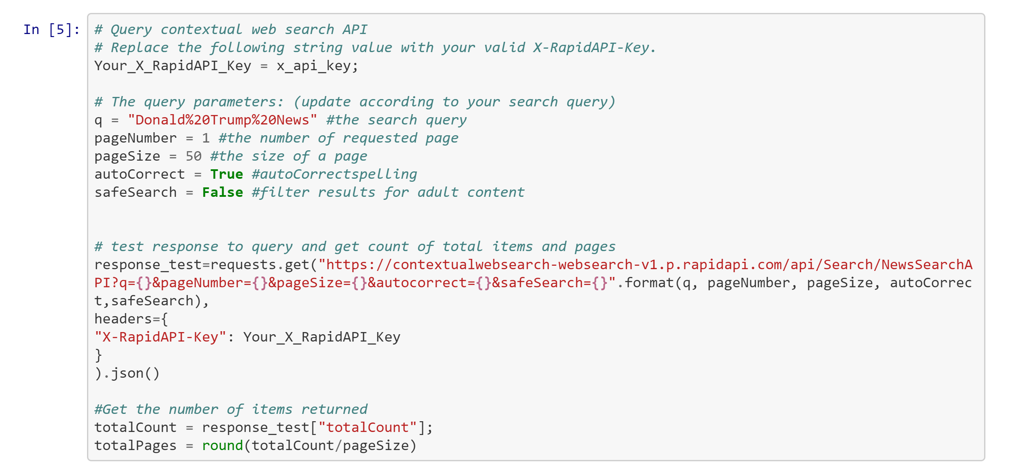
Methodology
We went through several iterations of news data sources, but eventually settled on the Contextual Web NewsSearch API.
The API takes in a query "q" and returns an article headline, description, publishing date, keywords, URL and news provider.

Slide 6
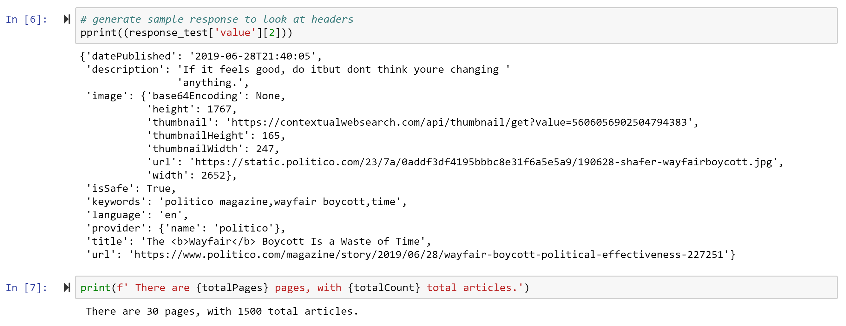
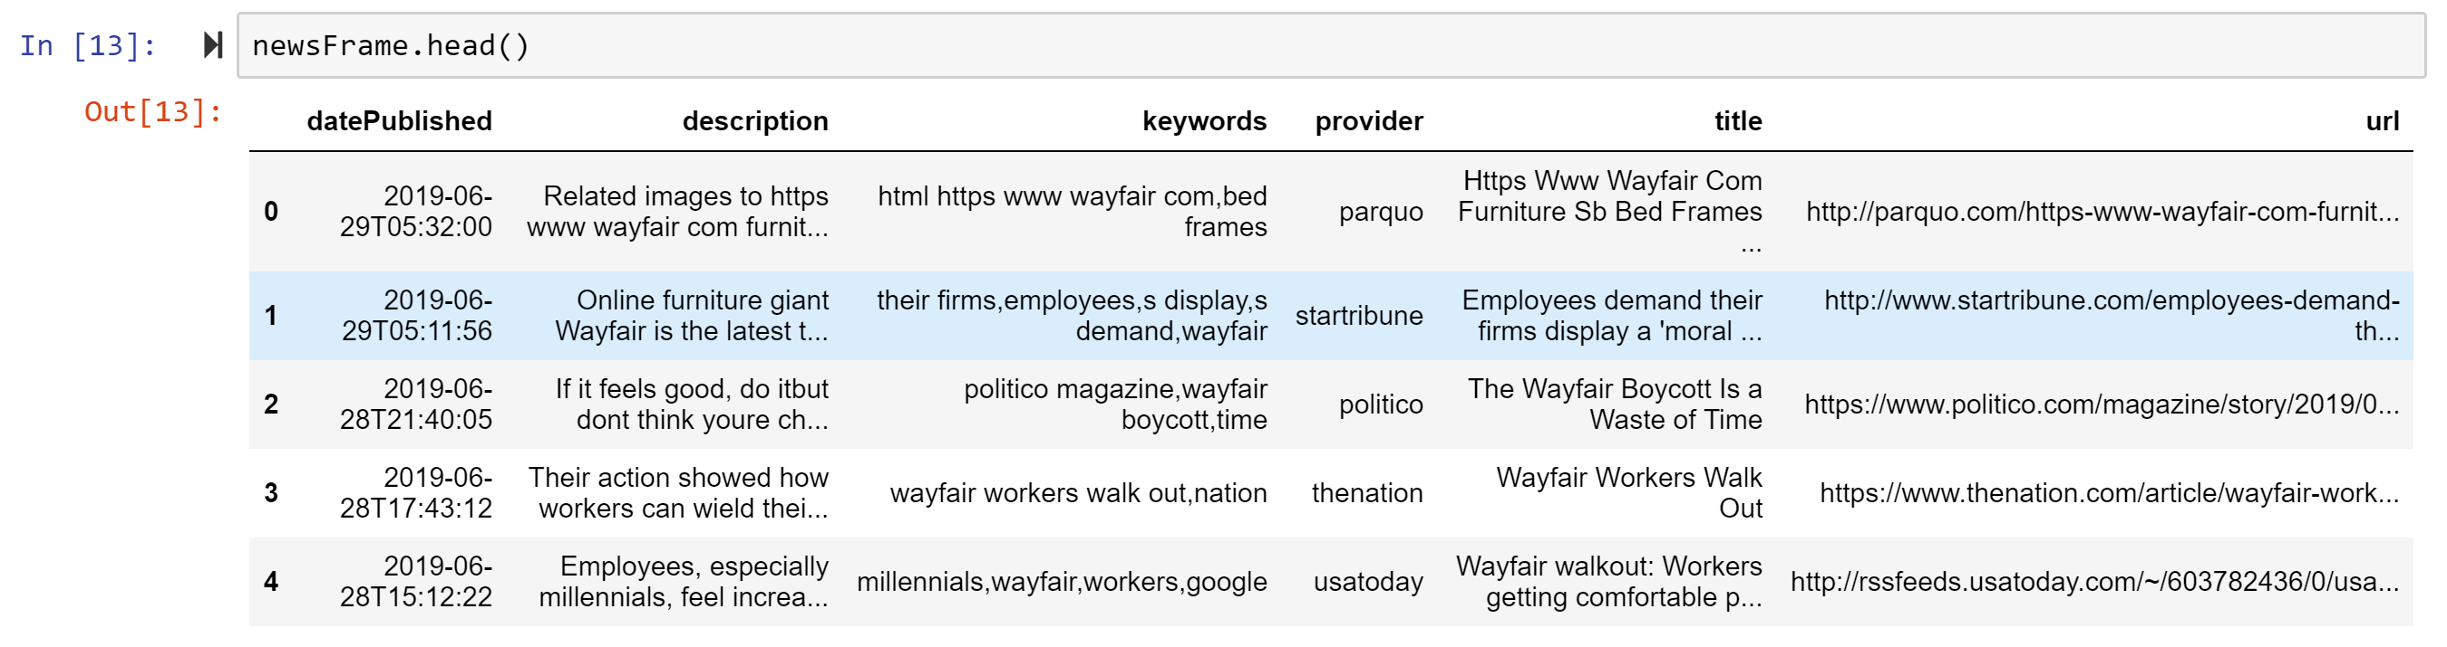
Sample of JSON Result
Our Initial DataFrame

Slide 7
SENTIMENT ANALYSIS
To do the sentiment analysis of the news data, we used vaderSentiment, a Python library built to do sentiment analysis of social media texts, but also widely applicable to all ranges of textual data.
Normalized weighted composite score
Positive sentiment: compound score >= 0.05
Neutral sentiment: (compound score >= 0.05) and compound score < 0.05)
Negative sentiment: compound score <= -0.05
Ratios for proportions of text that fall in each category
Notes:
Uses punctuation, bolds, repetition of statements, degree modifiers, conjunction and other textual features to qualify a text as “Positive”, “Neutral", or “Negative”

Slide 8
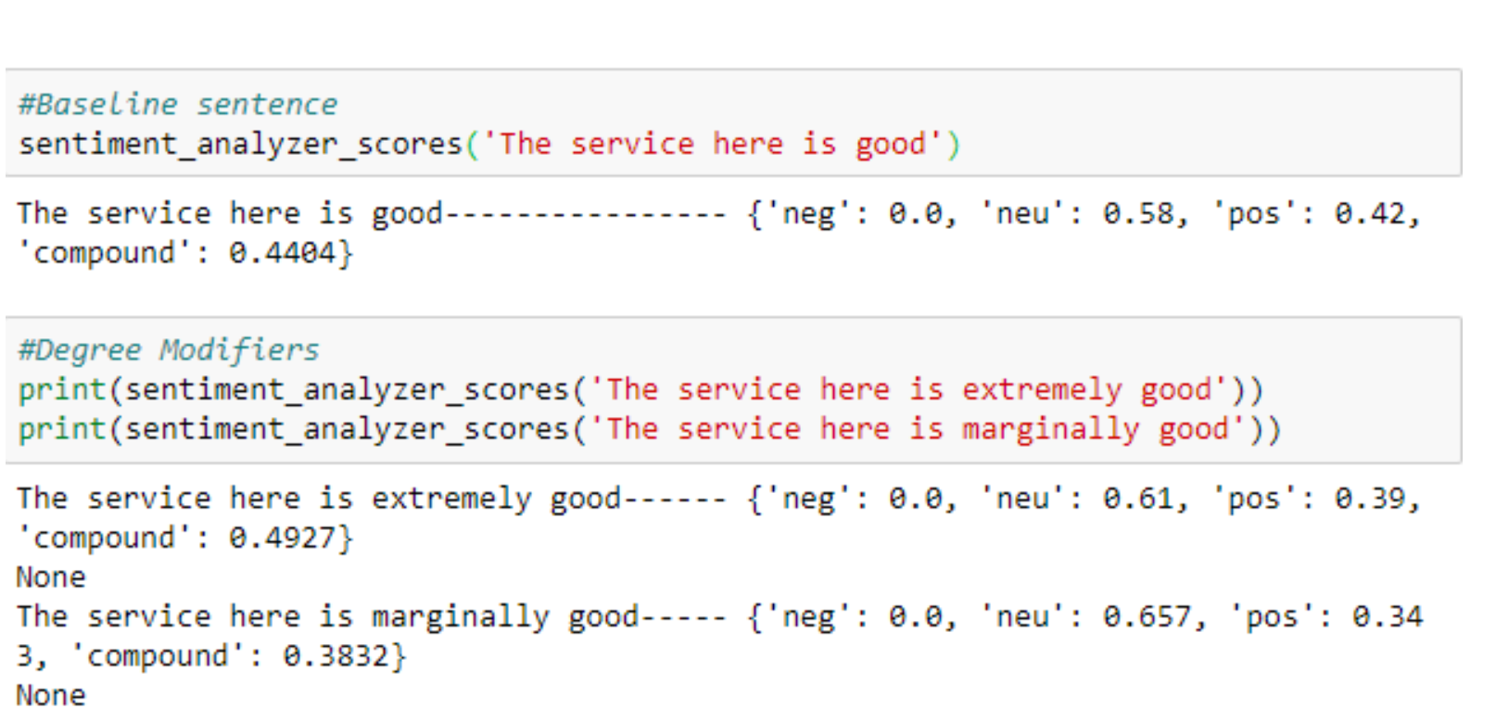
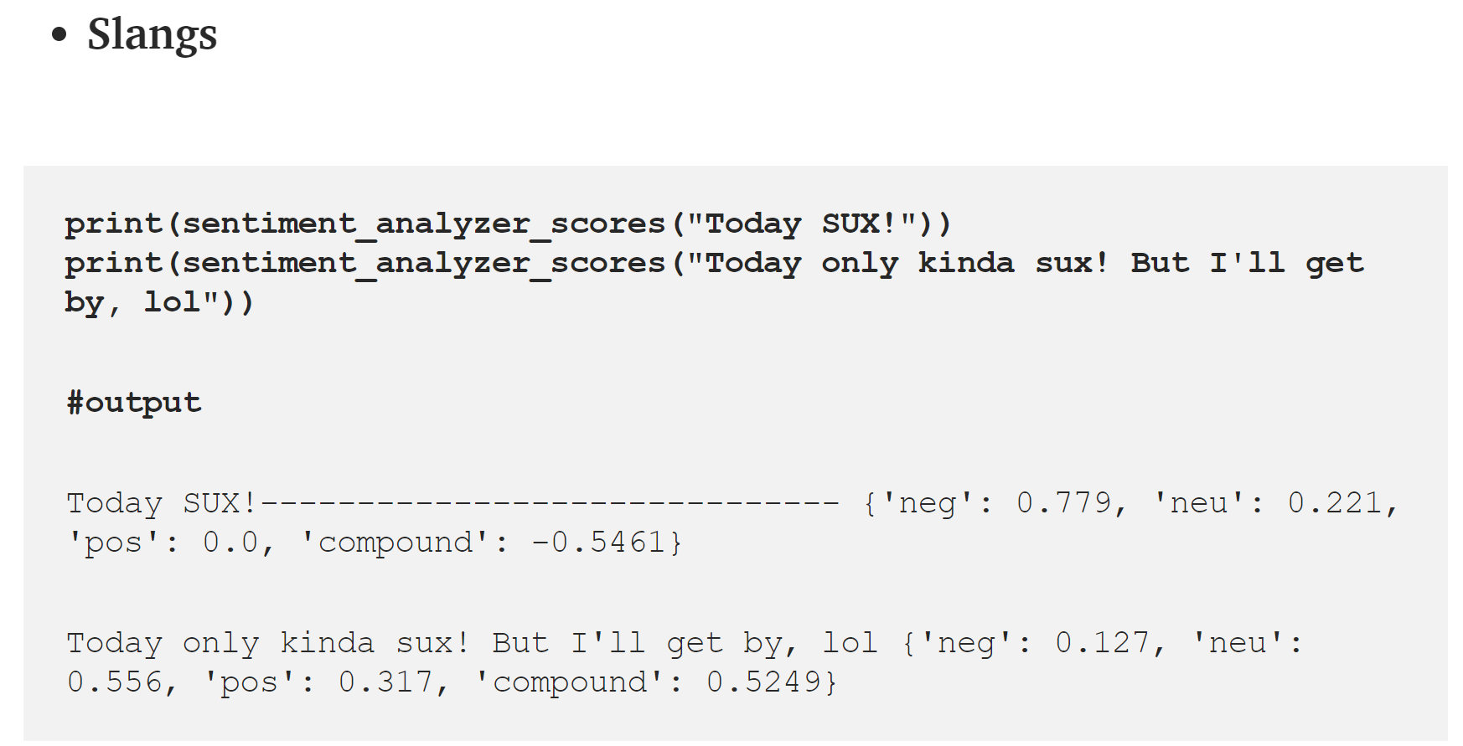
Examples of how VaderSentiment Treats Varying Texts

Slide 9
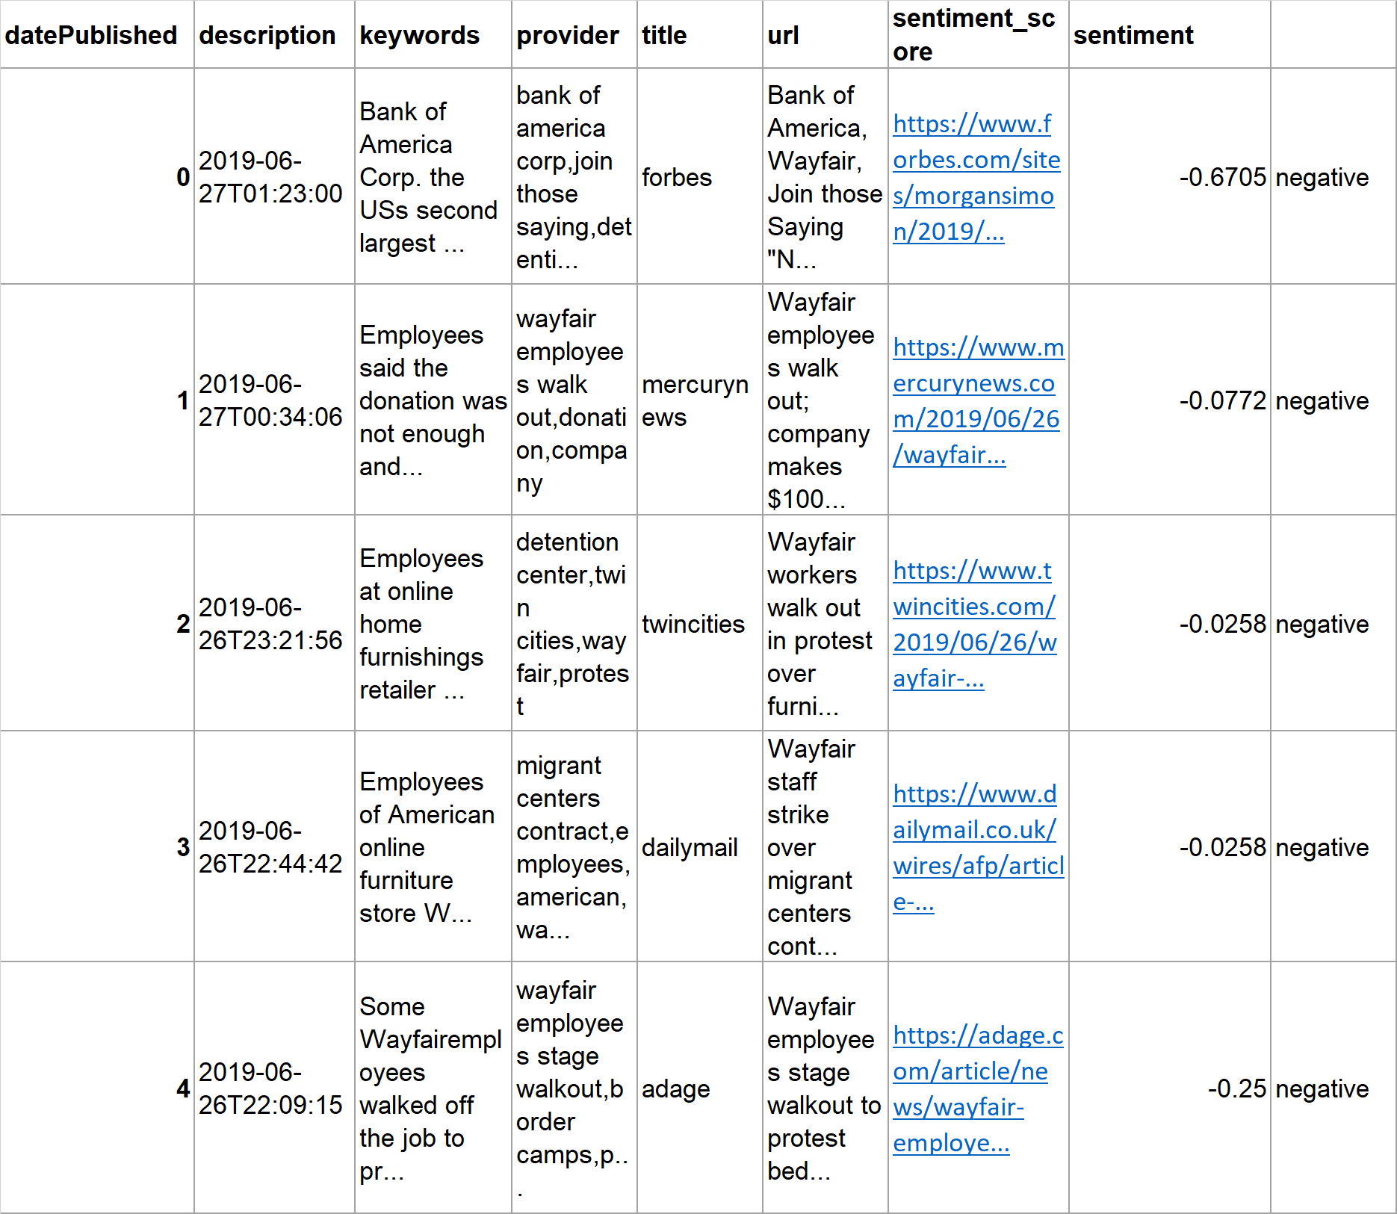
We pulled the combined compound sentiment score into the dataframe using the headline description as our argument.

Slide 10
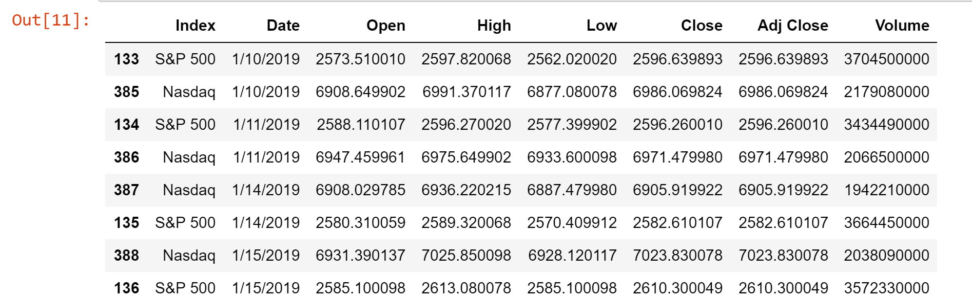
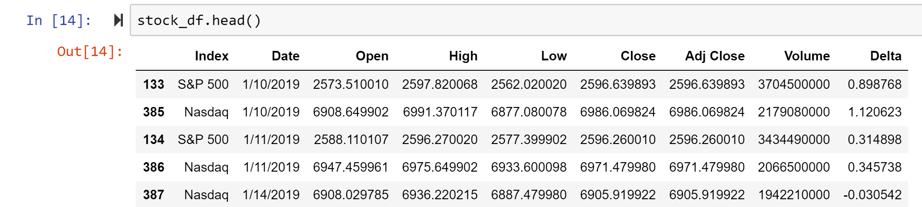
Completing the Data Set
In order to compare changes in price, we looked at the delta (Close – Open)/Open to be able to normalize data over time.

Slide 11
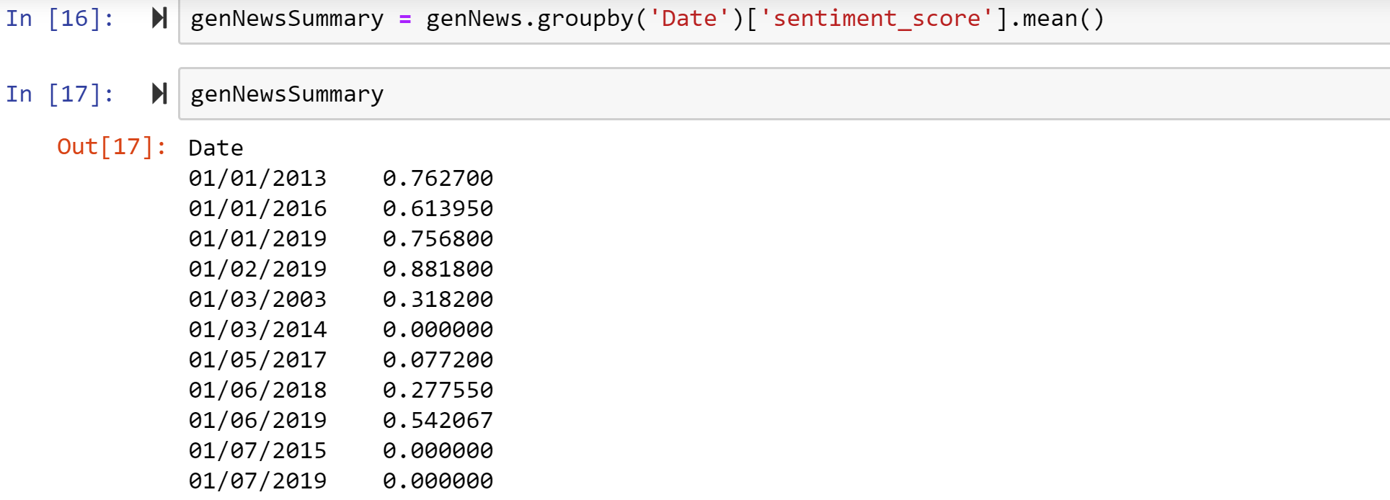
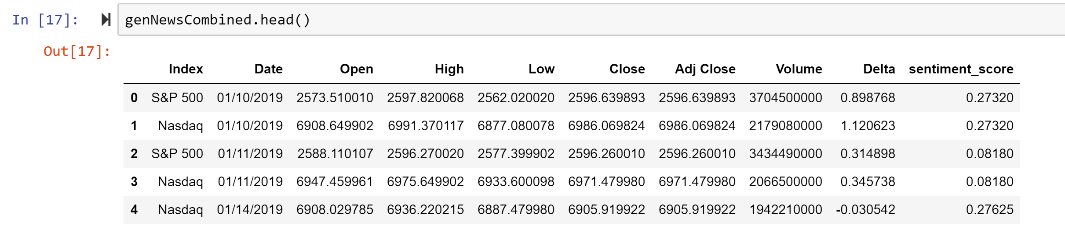
We calculated the mean sentiment score by date and merged that mean score with the financial data

Slide 12
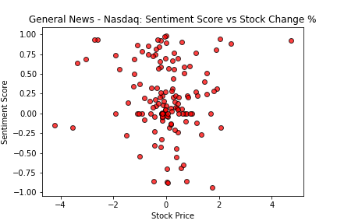
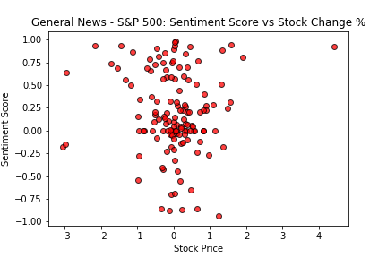
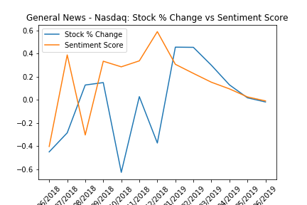
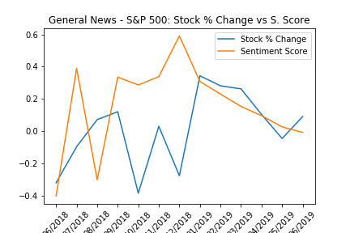
General News: Sentiment Score Vs Stock Change %
Notes:
The correlation between the delta and sentiment scores for General News S&P 500 is -0.020960730843469774, with a P value of 0.8086156111855279 (Top Left)
The correlation between the delta and sentiment scores for General News Nasdaq is -0.03871689247380876, with a P value of 0.6545047428559096(Top Right)
The correlation between the delta and sentiment scores for the General News Nasdaq summary is 0.010307127215561844, with a P value of 0.9733407473643522 (Bottom Left)
The correlation between the delta and sentiment score trends for the General News S&P 500 Summary is 0.03131857902173626, with a P value of 0.919101064452605 (Bottom Right)

Slide 13
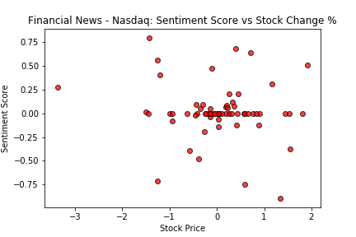
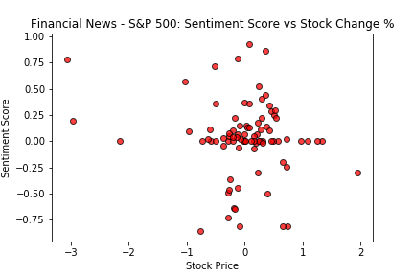
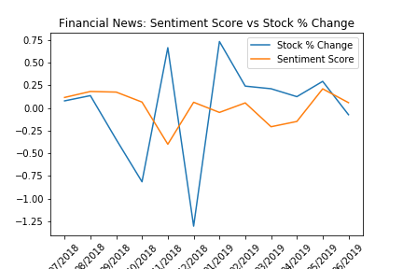
Financial News: Sentiment Score Vs Stock Change %
Notes:
The correlation between the delta and sentiment scores for Financial News and the Nasdaq is 0.08068918367301078, with a P value of 0.4272264847780394 (Top Left)
The correlation between the delta and sentiment scores for Financial News and the S&P 500 is 0.028993001692546944, with a P value of 0.7757415224649782 (Top Right)
The correlation between the delta and sentiment scores for Financial News and general Sentiment is -0.3193318711579122, with a P value of 0.3384573766313927 (Bottom)

Slide 14

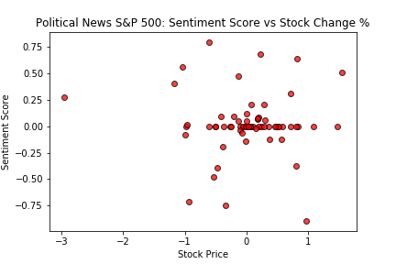
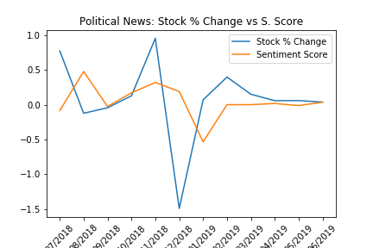
Political News: Sentiment Score Vs Stock Change %
Notes:
The correlation between the delta and sentiment scores for Political News and the S&P 500 is -0.13248077656844123, with a P value of 0.30064671700933465 (Top Left)
The correlation between the delta and sentiment scores for Political News and the S&P 500 is -0.041178514734699564, with a P value of 0.7486384166889715 (Top Right)
The correlation between the delta and sentiment scores for Political News and the S&P 500 by month is -0.10177243015219975, with a P value of 0.7529711603805183 (Bottom)

Slide 15
The analysis suggests little correlation between news and index performance when looking at all news. However, when news is narrowed to that which relates to finance or politics the data suggests a strong alignment of sentiment and market movement.

Slide 16
Unexpectedly, the movement of the news seems to follow the movement of the index, not the other way around. Seemingly, investors are impacted by the information in the news but are ahead of the reporting of it.

Slide 17
Are “cancelled” companies ever really cancelled?
How influential is a public scandal on a company’s stock price?

Slide 18
BAD BUSINESS PRACTICIES AND MEDIA SCRUTINY
Wells Fargo
March 28, 2019 - Tim Sloan resigned as chief executive, becoming the second CEO to leave the bank in the fallout of a wide-ranging sales practices scandal.
Tesla
September 28, 2018 - The Securities and Exchange Commission sues Tesla CEO Elon Musk making "false and misleading" statements to investors in an August 7, 2018 tweet. Later that month -- and after mocking the agency on twitter -- Musk settles with SEC for $20 million and steps down as chairman of Tesla. The company pays a $20 million fine as well and pledges to monitor Musk’s social media usage.
Wayfair
June 26, 2019 - Wayfair employees walk out of the company’s Boston-based HQs to protest Wayfair’s $200K sale of furniture to a contractor of migrant detention camps at the southern border.

Slide 19
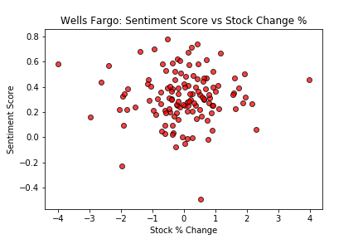
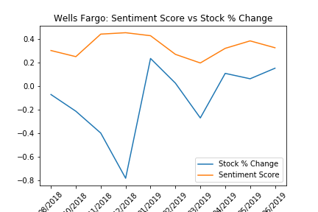
Wells Fargo:
Sentiment Score
Vs
Stock Change %
Notes:
The correlation between the delta and sentiment scores for Wells Fargo News is 0.014297576836619485, with a P value of 0.8737488103381466 (Top)
The correlation between the delta and sentiment scores for Wells Fargo Monthly News is -0.34725875837095904, with a P value of 0.32553659641719607 (Bottom)

Slide 20
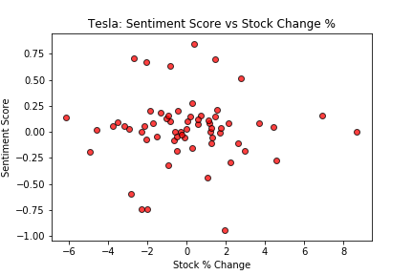
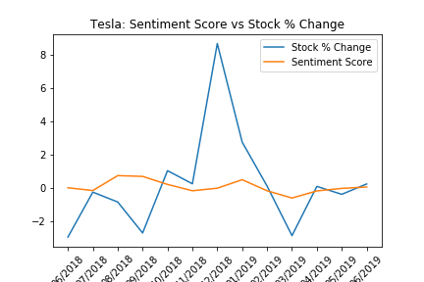
Tesla:
Sentiment Score
Vs
Stock Change %
Notes:
The correlation between the delta and sentiment scores for Tesla News is 0.17873183173657342, with a P value of 0.17560049751575973 (Top)
The correlation between the delta and sentiment scores for Tesla monthly News is 0.192292999216793, with a P value of 0.549346901606173 (Bottom)

Slide 21
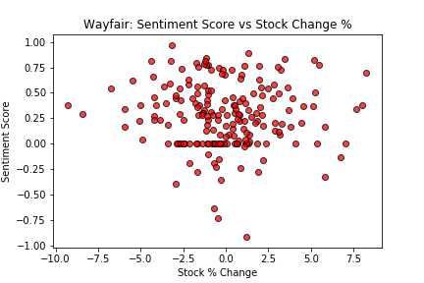
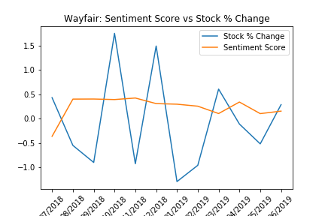
Wayfair:
Sentiment Score
Vs
Stock Change %
Notes:
The correlation between the delta and sentiment scores for Wayfair News is -0.04346585395311832, with a P value of 0.5494192047471895 (Top)
The correlation between the delta and sentiment scores for Wayfair Monthly News Trends is -0.18018764419871044, with a P value of 0.5752133184786916 (Bottom)

Slide 22
For Wells Fargo, small dips in sentiment seem to result in large dips in stock value. However the largest dip, in December 2018, was not related to Wells Fargo news but rather sector performance as a whole.
For Tesla, news sentiment remained neutral overall while stock performance fluctuated. Like Wells Fargo, this suggests influence from other factors.
For Wayfair, news sentiment remained positive overall until March 2019 when we observe a dip in both sentiment and stock price, followed immediately by a rebound in first the news then the stock price. This likely indicates a reaction surrounding first quarter earnings.

Slide 23
It appears that all 3 companies suffer only short term losses at the hands of the media, post scandal. The stock behavior is controlled by what appear to be more influential factors.

Slide 24
“Uncertainty is the only certainty”
While the news sentiment and stock/index behavior is correlated, additional analysis would be necessary to determine causality. To explore further, data sets can be narrowed by date and other influential factors can be introduced to rule out their level of impact.

Slide 25
Thanks! Any Questions?

